Slide 1
Introduction before the Omnitags
Khenjy Johnelson
Notes:
Teaching a web template engine that is unfamiliar to most people can be challenging, especially if the instructor is already very comfortable with it.
### Example Outline for a Teaching Session
1. *Introduction to Template Engines*
- What is a template engine?
- Benefits of using a template engine
2. *Getting Started*
- Installation and setup
- Basic syntax and structure
3. *Core Features*
- Variables and expressions
- Loops and conditionals
4. *Advanced Topics*
- Partial templates and includes
- Template inheritance
5. *Practical Application*
- Building a simple web page
- Integrating with a backend
6. *Hands-On Workshop*
- Live coding session
- Interactive exercises
7. *Q&A and Discussion*
- Addressing common issues
- Sharing tips and best practices
By following these strategies, you can effectively teach a web template engine, even if it is unfamiliar to most of your audience. The key is to break down the learning process, provide ample practice opportunities, and relate new concepts to familiar ones.
Here are some strategies to effectively teach such a tool:
### 1. *Start with the Basics*
- *Introduction*: Begin with a clear explanation of what a template engine is and why it is useful.
- *Use Cases*: Provide real-world examples where the template engine simplifies tasks.
### 2. *Break Down the Learning Process*
- *Basic Syntax and Concepts*: Start with the basic syntax and fundamental concepts. Use simple examples to illustrate each concept.
- *Progressive Complexity*: Gradually introduce more complex features and scenarios.
### 3. *Use Visual Aids*
- *Diagrams and Flowcharts*: Use diagrams to explain how the template engine processes data and generates HTML.
- *Code Snippets*: Show side-by-side comparisons of code before and after applying the template engine.
### 4. *Hands-On Practice*
- *Live Coding*: Demonstrate coding live to show the process in real-time.
- *Interactive Exercises*: Provide exercises for students to practice what they’ve learned. Use pair programming to encourage collaboration.
### 5. *Provide Clear Documentation*
- *Cheat Sheets*: Create cheat sheets with common syntax and commands.
- *Step-by-Step Guides*: Offer detailed guides that walk through the process of setting up and using the template engine.
### 6. *Encourage Questions and Discussions*
- *Q&A Sessions*: Allow time for students to ask questions and discuss challenges.
- *Discussion Forums*: Use forums or chat groups to facilitate ongoing discussion and support.
### 7. *Relate to Known Concepts*
- *Analogies and Comparisons*: Relate the template engine to concepts students already know (e.g., comparing it to other template engines or programming paradigms).
### 8. *Real-World Projects*
- *Project-Based Learning*: Assign projects that require students to use the template engine to solve problems.
- *Incremental Projects*: Break projects into smaller, manageable tasks that build on each other.
### 9. *Feedback and Iteration*
- *Regular Feedback*: Provide regular feedback on assignments and projects.
- *Iterate and Improve*: Use feedback to improve the teaching approach and materials.
### 10. *Showcase Benefits*
- *Performance and Efficiency*: Demonstrate how the template engine improves performance and development efficiency.
- *Case Studies*: Share case studies or testimonials from companies or projects that have successfully used the template engine.

Slide 2
Outline
Part 1:Preface
Part 2: Introduction
Part 3: The Thing about Global Variable
Part 4: My Story

Slide 3
Preface
Who am I
Why I made this course?

Slide 4
Who Am I?
My Profile

Slide 5

My Profile
Name: Khenjy Johnelson
Born: Batam, 18 July 2004
School: SMK Putra Batam
Univ: Universitas Universal
Hobby: Reading Wikipedia, find new words or terms

Slide 6
Why I made this course
Cargo cult programming
Why we should avoid it

Slide 7

Cargo cult programming
Cargo cult programming is a style where programmers include unnecessary code or patterns without fully understanding their purpose, often just mimicking other code they’ve seen without knowing why it’s there. This approach can lead to ineffective, cluttered code and is often a sign of misunderstanding either a problem or its solution.

Slide 8

Cargo cult Programming
Avoiding cargo cult programming is crucial for writing clear, efficient code. Instead of copying code or design patterns blindly, developers should strive to understand the underlying concepts and apply them thoughtfully. This prevents unneeded complexity and ensures that each line of code serves a purpose, contributing to cleaner, more maintainable codebases.

Slide 9
Introduction
How most software development works (at the core of it)

Slide 10
How most software development works (at the core of it)
Local variable
Modular programming
Global Variable

Slide 11
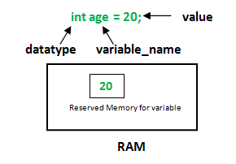
Local Variables
In computer science, a local variable is a variable that's only accessible within a specific function or block where it’s defined. When you use a local variable inside a function, it takes priority over variables with the same name that might exist outside of that function, like in the broader program.
Reference:
https://en.wikipedia.org/wiki/Local_variable

Slide 12
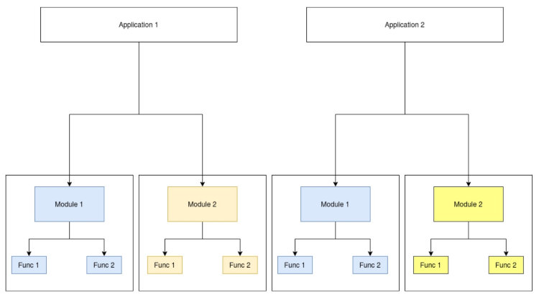
Modular Programming
Modular programming is a software design approach focused on breaking down a program’s functionality into separate, self-contained modules. Each module handles a specific function or "concern" within the overall program, and includes everything it needs to perform that task independently of other parts of the program.

Slide 13
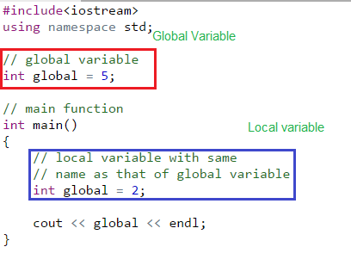
Global Variable
In programming, a global variable is a variable that’s accessible from anywhere in the program, giving it a global scope. This means any part of the program can read or modify it—unless a local variable with the same name “shadows” it by temporarily taking priority in a particular block or function. The collection of all global variables forms what’s known as the global environment or global state.

Slide 14
The thing about Global Variable
5W + 1H
Variable comparisons

Slide 15
5W + 1H
What is global variable
Who use it
Where is it placed
When to use it
Why even bother

Slide 16
What is global variable
A global variable is a variable that is accessible throughout the entire program, from any function or block, unless it’s specifically overridden in a local scope.

Slide 17

Who use it
Programmers working on applications that need to share data or configurations across multiple functions or modules may use global variables. They are commonly used in both simple scripts and large programs, though often sparingly in larger applications.

Slide 18
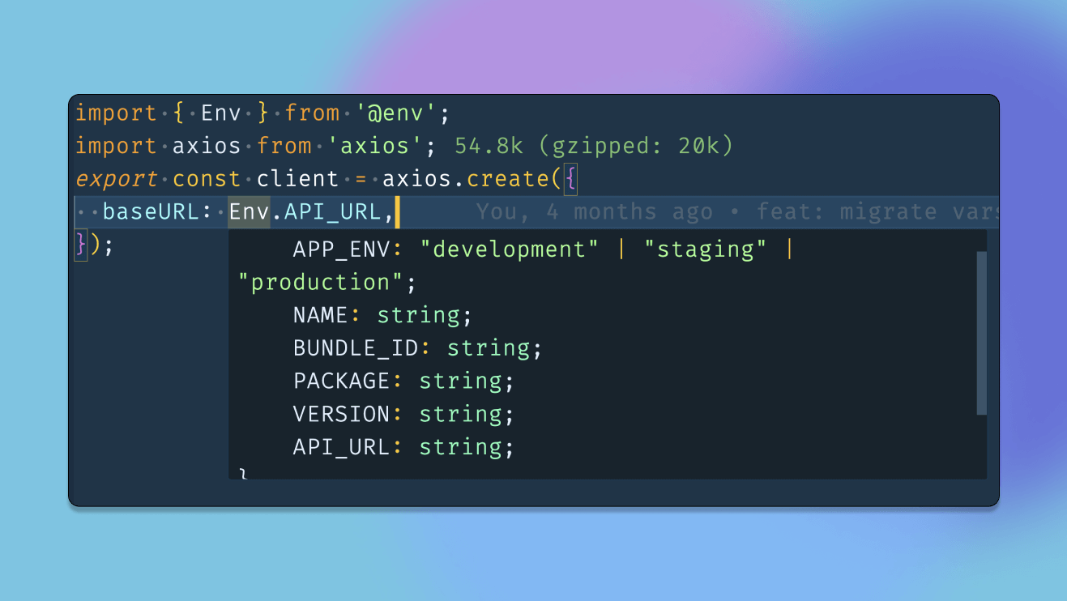
When to use it
Global variables are used when data needs to be universally accessible, such as configuration settings, constants, or data shared across multiple parts of the program. They’re especially useful in small programs but can become problematic in larger, more complex applications.

Slide 19
Where is it placed
Global variables are typically declared at the top level of a program or module, outside of any function or class. In some languages, they’re defined within a dedicated configuration file or global settings section.

Slide 20
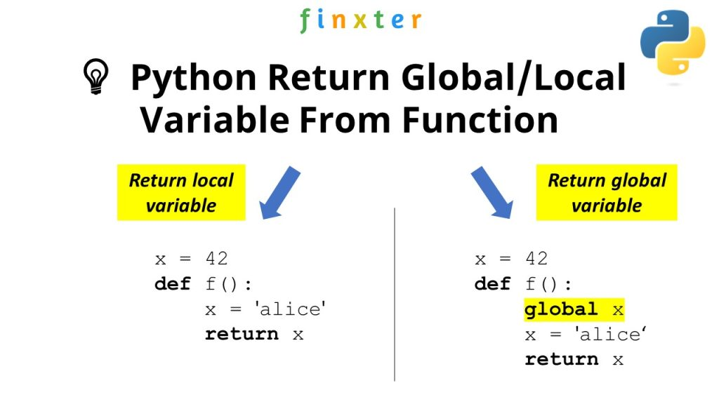
Why even bother
Global variables simplify access to data that needs to be widely available, making the code less repetitive and reducing the need for passing variables between functions. However, they can also introduce risks, like unintended modifications and dependencies, which can make debugging and testing more challenging.

Slide 21
In comparisons to other types of variables
Local variable vs global variable
Environment variable
Postman environment

Slide 22
Local Variable vs Global Variable
Local Variable: A local variable is defined within a function or block and is only accessible there. It exists temporarily while the function or block is running and is deleted afterward. Local variables help keep data isolated, reducing the chance of unintended changes elsewhere in the program.
Global Variable: A global variable is defined outside any function or block, making it accessible throughout the entire program. It exists for the program’s entire runtime and retains its value across function calls. Global variables are often used for data that needs to be shared across multiple parts of the program, like configuration settings.

Slide 23
Environment Variable
Environment Variable: Environment variables are part of the operating system’s environment and are accessible to any program running on the system. They store information like file paths, system preferences, or API keys, allowing applications to adapt to different environments without hardcoding values. They can be set temporarily for a session or permanently in system configuration files.

Slide 24
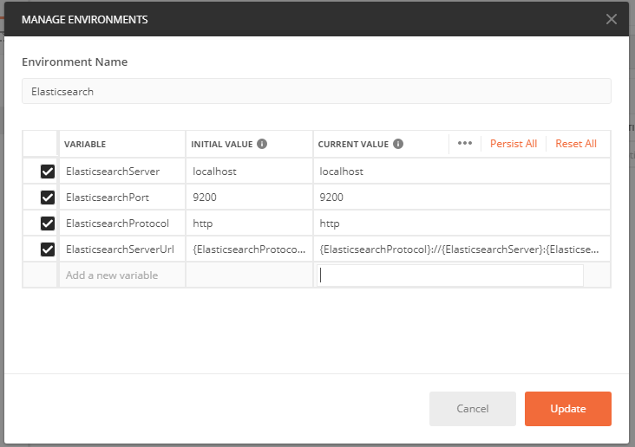
Postman Environment
Global variables in Postman are universally available across all requests and environments, while environment variables are scoped to a particular environment and can vary based on the context of your API testing. Both can be used for dynamic variable management, making it easier to test and switch between different environments or configurations.

Slide 25
My Story
How it came to picture
My tech preference and reasons

Slide 26
How it came to picture
The original idea
The way to realize it

Slide 27
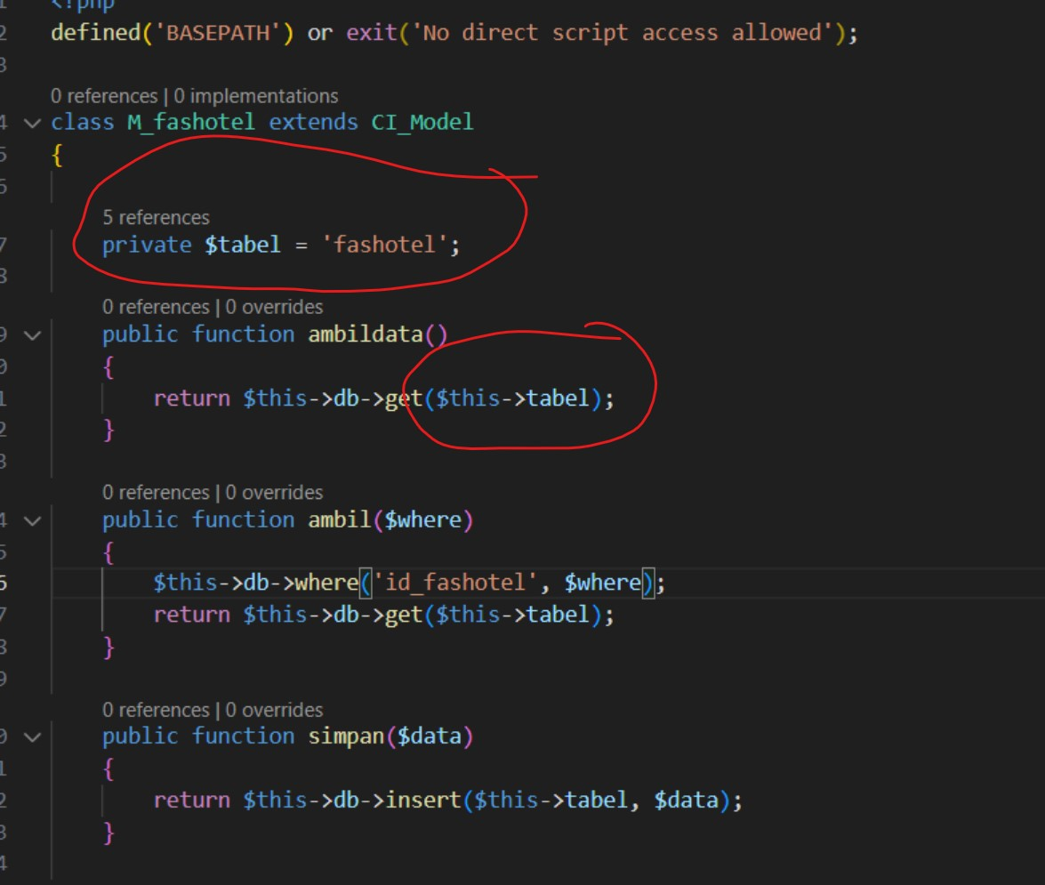
The original idea
I want to replicate this line of code, but at big scale
I want to solve things like
Modularity issues
Inability for 1 single dev to thrive in big projects
Inconsistencies

Slide 28
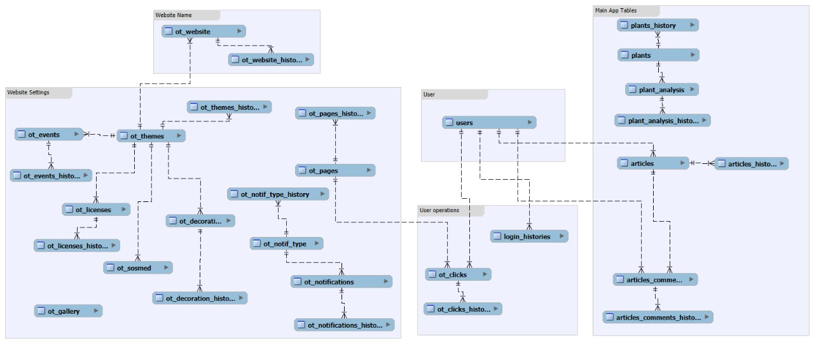

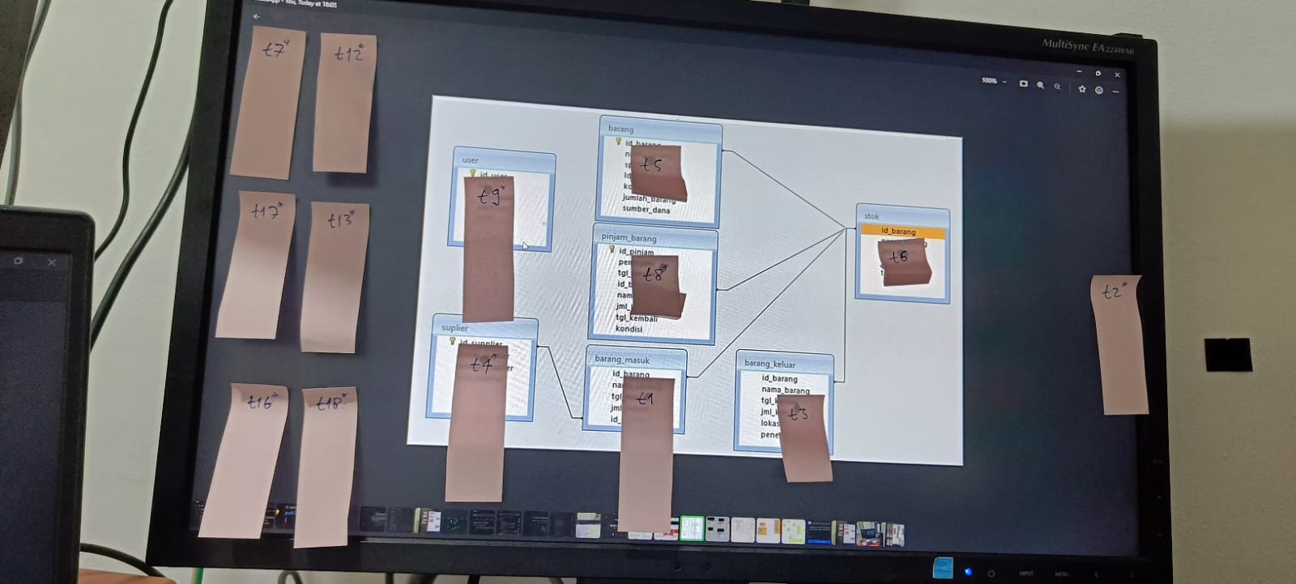
The way to realize it
I spend around 6 months or more planning and making this possible, even learning the basics on how tables connect with each other

Slide 29
My tech preference and reasons
Codeigniter 3
Bootstrap 4

Slide 30

Codeigniter 3
Codeigniter 3 isn’t the standards of web development nowadays, it’s Laravel (especially v11).
Codeigniter 3 also has a lot of problems to begin with
But its light, simple to use, and experienced by me
The flexibility of codeigniter 3 is enough for me the sole reason I keep using it for this research

Slide 31

Bootstrap 4
Bootstrap 4 are also the same, the most used one nowadays is either bootstrap 5, tailwind, and others.
But I’m more of a backend developer than frontend, so I use the thing that I already utilize most

Slide 32
The way I intended to use global variable on codeigniter 3 is like making a mcdonalds to solve the African food crisis.
Khenjy Johnelson

Slide 33
References
https://web.archive.org/web/20121204081204/http://www.phpwact.org/pattern/template_view
https://learning.postman.com/docs/sending-requests/variables/variables/
https://community.postman.com/t/how-to-set-and-get-dynamic-environmental-variable/7482

Slide 34
More here
Discuss
Ask Questions
Collab
Discord:
https://discord.gg/4pTNSCQbvw

Slide 35
Thank You
khenjyjohnelson123@uvers.ac.id

